Slide 1

Mechanical and Dielectric Properties of Polymers and Metal-Organic Frameworks
Ricardo Silva Buarque
05/26/2022

Slide 2
DMAx tutorial
1 - On your home directory, run: wget https://repo.anaconda.com/miniconda/Miniconda3-latest-Linux-x86_64.sh
Alternatively, copy the file /expanse/lustre/projects/csd626/ricardosb/DMAx_TUTORIAL/Miniconda3-latest-Linux-x86_64.sh to your home directory
2 - On your home directory, run: chmod +x Miniconda3-latest-Linux-x86_64.sh
3 - On your home directory, run: bash Miniconda3-latest-Linux-x86_64.sh
4 - Accept all installation requirements from Miniconda with "yes"
5 - Run: source ~/.bashrc
6 - Run: conda create -n cms python=3.9
7 - Run: source activate cms
8 - Run: conda install numpy scipy matplotlib pandas jupyter sklearn
9 - On your home directory, run: git clone https://github.com/sdsc-hpc-training-org/reverse-proxy.git
10 - On your home directory, run: mkdir scripts_YOUR_USERNAME && cd scripts_YOUR_USERNAME
11 - Enter your bashrc file (vi ~/.bashrc) and add the following aliases and exports:
alias jupyter="cd ~/reverse-proxy/ && ./start-jupyter -p 'shared' -d '/expanse/lustre/projects/csd626/YOUR_USERNAME/' -A 'csd626' -b './slurm_expanse/jupyterlab.sh' -I“
alias brc="vi ~/.bashrc"
alias sourcebrc="source ~/.bashrc“
export PYTHONPATH=/home/ricardosb/scripts_YOUR_USERNAME
12 - Inside the created scripts directory, run: git clone https://github.com/rsilvabuarque/DMAx.git
13 - Inside the DMAx directory, run: git checkout ricardo
14 - Inside DMAx/dist, run: pip install DMAx-1.0.tar.gz
15 - Run: jupyter -t 1:00:00
All instructions are in: /expanse/lustre/projects/csd626/ricardosb/DMAx_TUTORIAL/README.md

Slide 3
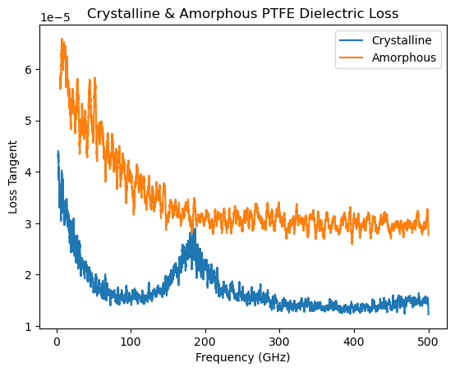
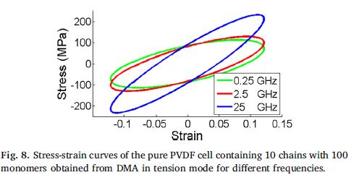
Properties studied
Mechanical Loss
Reasons for studying
Determining risk of mechanical failure and degradation rate for antennae and high-frequency devices
Determining mechanical heat generation in high-frequency microchips
Dielectric Loss
Reasons for studying
Determining risk of failure and heat generation caused by high-frequency oscillating electric fields

Slide 4
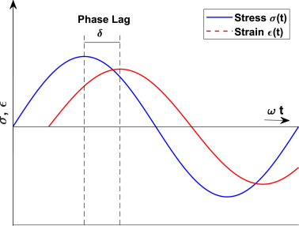

Mechanical Loss (Theory)
Original stress applied by fix deform
Pressure response captured in LAMMPS output
Dynamic Mechanical Analysis: calculates the material’s tendency to store energy elastically vs dissipate energy through heat
Storage Modulus (G’)
Loss Modulus (G”)
Loss Tangent: G” / G’ (tan 𝛿)
Measuring with LAMMPS
Running an NVT production dynamics with the fix deform wiggle term and saving pressure tensor information

Slide 5
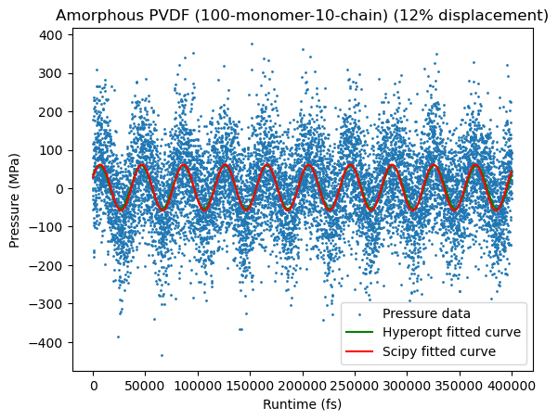
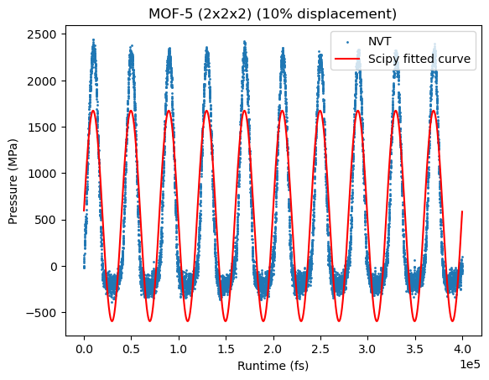
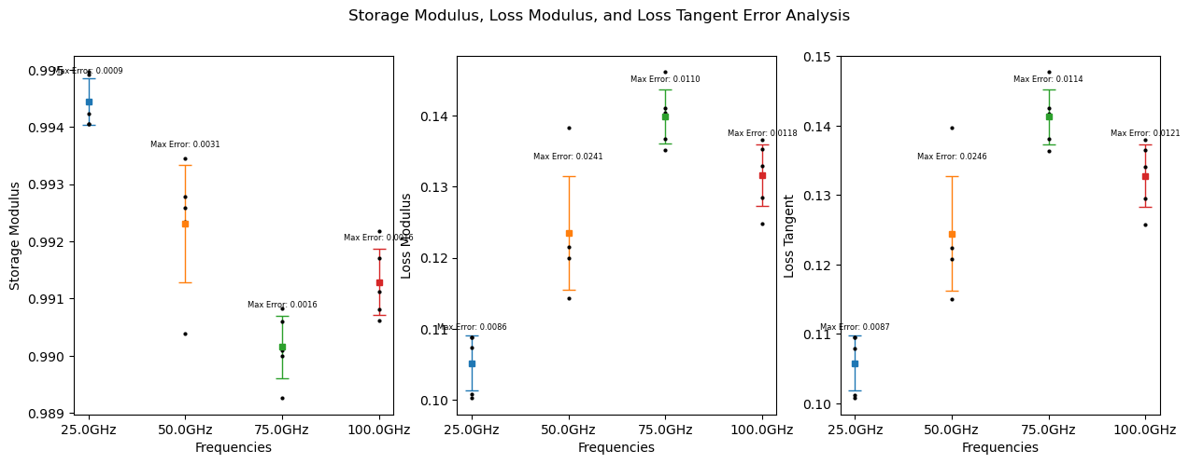
Mechanical Loss (DMAx Package)
DMAx: High-throughput python workflow for calculating Dynamic Mechanical Analysis with LAMMPS (EARLY ALPHA!!)
Features: runtime convergence, strain size convergence, error margin analysis, master curve generation
Future features: integration with FireWorks and jobflow (which allows for sequential submission of workflow tasks and GUI visualization of workflow completion), integration with Materials Project and ML model to predict properties of other systems without running MD

Slide 6
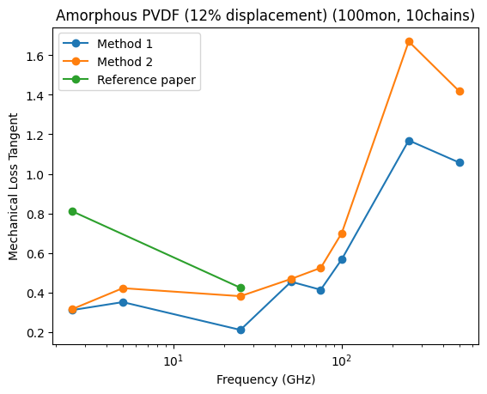
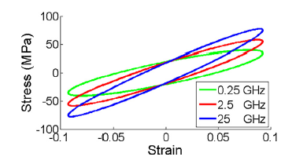
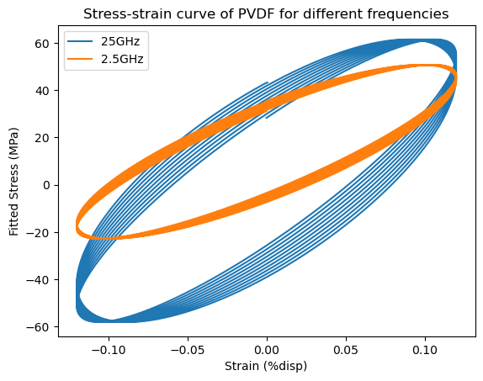
Mechanical Loss (Results)
Loss data agrees in magnitude with currently available work at 25GHz
However, data trend between 2.5 and 25GHz differs
Stress-strain curve indicates degree of crystallinity
Stress-strain curve for fully viscous liquids are circle
Stress-strain curve for fully elastic materials are a line crossing the origin
Slope of major axis of ellipse = elastic modulus

Slide 7
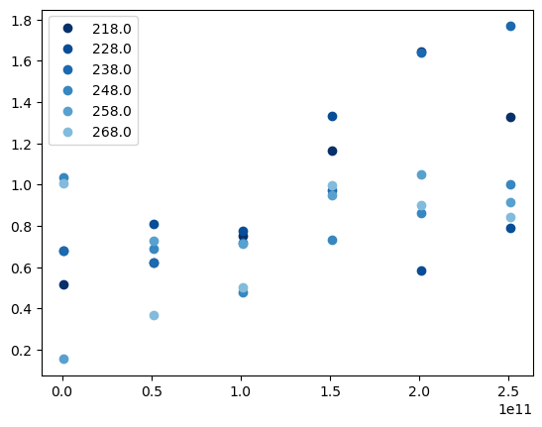
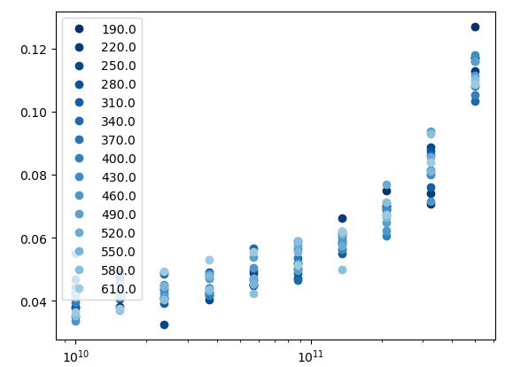
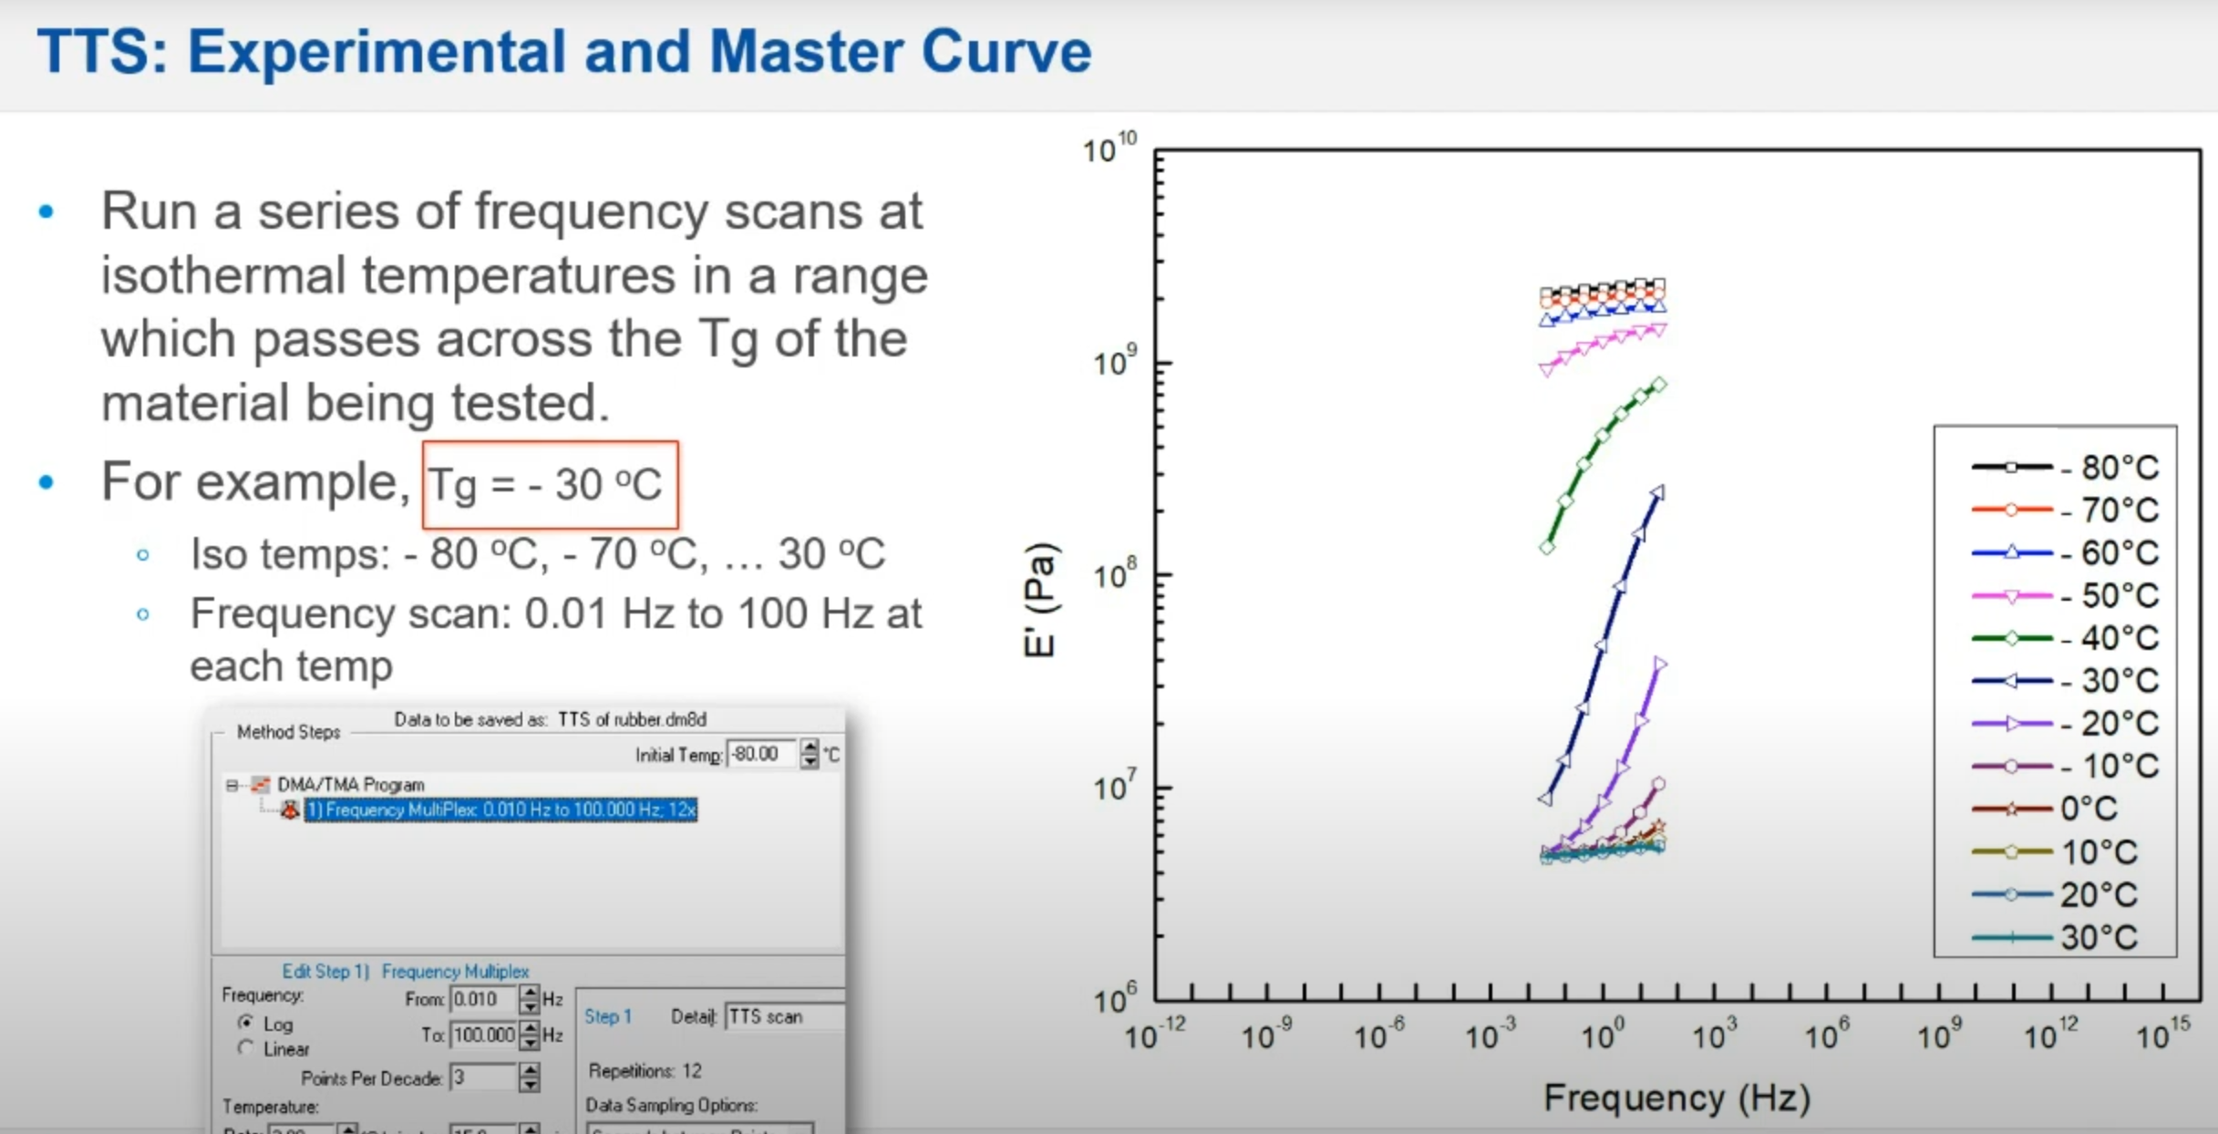
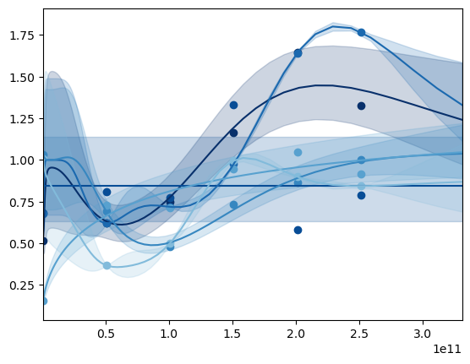
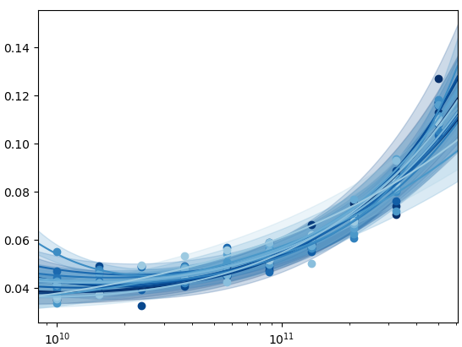
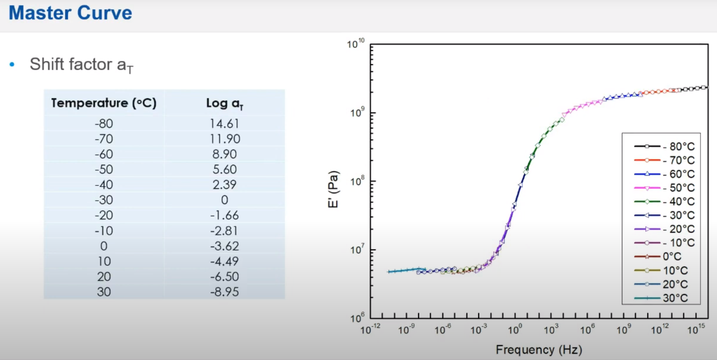
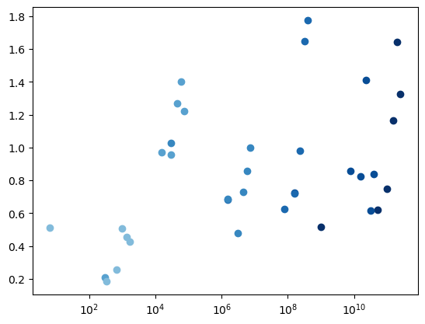
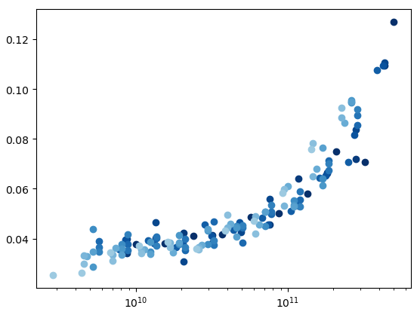
Mechanical Loss (Master Curve Results)
PVDF (amorphous / crystalline) DMA data (tangent)
Master Curves: based on polymeric trends, allow for estimation of material property values at unmeasurable regimes
Ultimate goal: validate high-frequency mechanical loss (unmeasurable experimentally) by extrapolating MD data to low frequencies and comparing to experimental data
Current data is either “too-trendy” or not trendy enough
Either gives a bad extrapolation or does not extrapolate to lower frequencies since shift factors are small

Slide 8
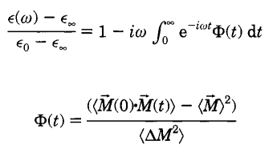


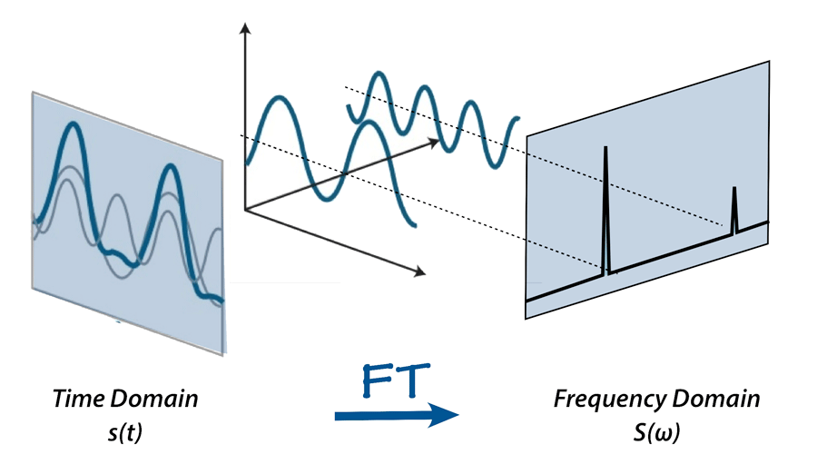
Dielectric Loss (Theory 1)
Frequency-dependent loss
Frequency-dependent dielectric Loss: obtained from the autocorrelation function of the total dipole moment
Kirkwood-Onsager and Green-Kubo theory -> observe fluctuations on properties in steady-state (equilibrium) to determine non-equilibrium properties of the material
For dielectric loss: observe fluctuations of dipole moment
Issue: only able to accurately determine small deviations from equilibrium
Static dielectric constant

Slide 9
Dielectric Loss (Theory 2)
Similar approach to frequency-dependent mechanical loss
Apply an oscillating E-field -> atoms move due to assigned charges generating a pressure oscillation -> analyze pressure response delay from applied field
Goal: observe far-from-equilibrium properties
Ex.: More intense or higher-frequency electric field oscillation
Limitation: does not work with neutral systems (no movement due to partial charges)
Original E-field signal applied by fix efield
Pressure response captured in LAMMPS output

Slide 10
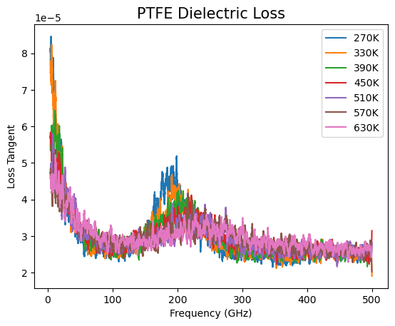
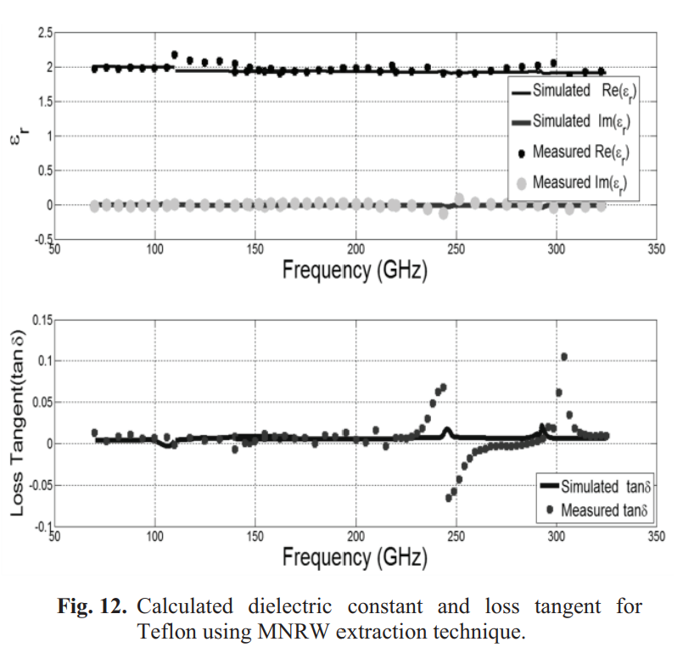
Dielectric Loss (Theory 1) (Results)
Correctly predicts trends in the dielectric behavior of PTFE
Known to have a dielectric loss peak at ~200GHz
Peak fades as the structure becomes amorphous
Seen both by approaching temperature to melting point and by designing an amorphous structure
Magnitude seems very off from expected values

Slide 11
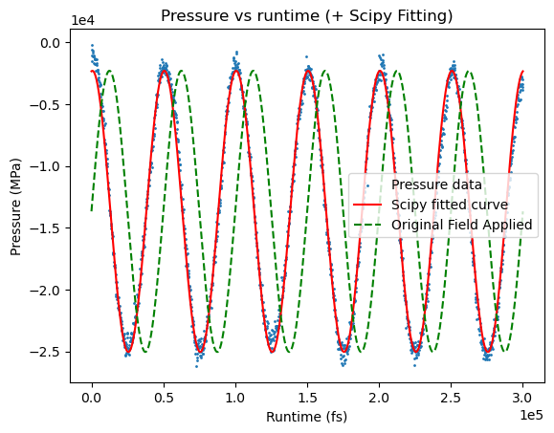
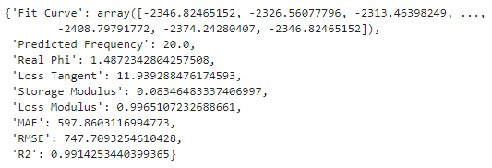
Dielectric Loss (Theory 2) (Results)
Observable shift in response from applied field
However, several orders of magnitude more lossy than theory 1
Next steps: understand “double frequency issue” and test new, less lossy materials
Small amorphous PTFE (450 atoms) @ 10GHz

